Slide 1
The road to Hell…
…is paved with best practices

Slide 2
Warning
<RANT>

Slide 3
Why…
Not all “best practices” seem to make us more secure.
Often overlooked:
“…when applied to a particular condition or circumstance.”

Slide 4
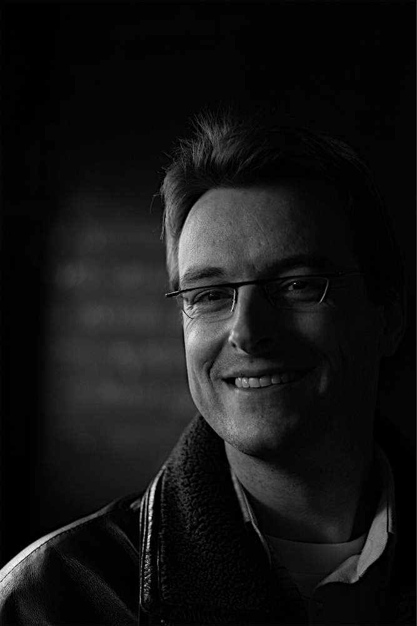
Who am I?
Frank Breedijk
Security Engineer at Schuberg Philis
Author of Seccubus
Blogging for CupFighter.net
Email: fbreedijk@schubergphilis.com
Twitter: @seccubus
Blog: http://www.cupfighter.net
Project: http://www.seccubus.com
Company: http://www.schubergphilis.com

Slide 5
The burden of administration…
“Adding more security” to a system often means more administration and bureaucracy.
It often also means less time to do actual system administration.

Slide 6
Firewalls from two different vendors…
Reasoning:
If one vendor has a serious flaw, there will not be a total compromise.
Reality:
Firewall bypass bugs are rare
Two rule bases
Two different technologies
Most likely outside firewall will pass anything nat-ed behind inside firewall
Most firewall brand use the same IP stack anyway

Slide 7
Its like two locks on a bicycle
Most bicycle thieves in Amsterdam only know how to quickly open one type of lock

Slide 8
But just two locks isn’t enough…
Like every technology you need to know how to apply it to benefit from it.

Slide 9
Is complexity bad?
There are about 25,000 parts in a commercial jet engine.
In order to make a working jet engine you need at a maximum 1,000 parts

Slide 10
Is complexity bad?
Complexity can also aid security…
It should never be the basis of your security
Never underestimate the power of security by obscurity
Obscurity can defeat plausible deniability
Encryption is a classical example of security by obscurity

Slide 11
What about encryption…

Slide 12
Encryption is not a silver bullet…
Many attacks:
Key theft
Brute force
Social engineering
End point compromise
Man in the browser attack
Man in the Middle attack
Downgrade attack
Rubber hose cryptology
Side channel attack
Cache timing attack
Replay attacks

Slide 13
If a “security measure” is too hard… it will more likely hurt
Password requirements:
Likely password:
7 characters
welcome
1 capital
Welcome
1 numeral
W3lc0m3
1 special
W3lc0m3!
10 characters
W3lc0m3!!!
30 days max – cannot use last 12
Welcome01!
The predictability of human behavior can aid in password cracking attempts.
See the work of Matt Weir:
"Using Probabilistic Techniques to Aid in Password Cracking Attacks“
http://tinyurl.com/RTHpasswd

Slide 14
Security making life too hard…
You cannot paste a password into an RDP login box
Consequences:
I set up a really hard adminstrator password
I put it in the password vault
I now have to type 15 random characters to gain access
I may start to remember this password
I may start to use weaker passwords
Maybe I will write the password down

Slide 15
Don’t turn system administration into an obstacle race…
If your only users are system administrators why would you:
Make home directory 600
Make roots home directory 100
Restrict access to /var/log
Etc…

Slide 16
There is strength in numbers…
“Limit the number of system administrators”

Slide 17
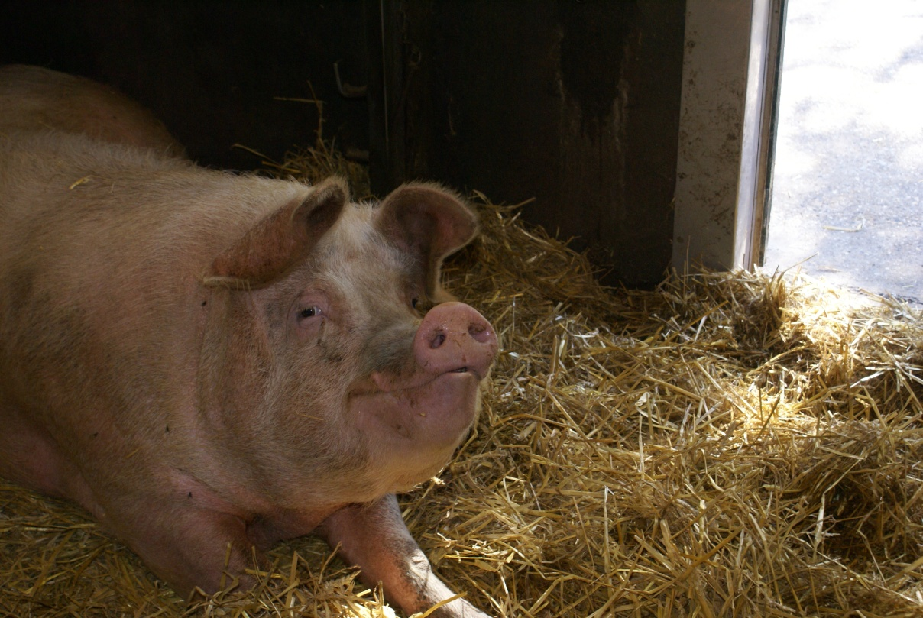
Does this consider the level of the system administrators?
Or are all animals equal…

Slide 18
What is the right number of administrators…
5
20
25
47
35
50
18
53
42
35
17
15
6
120
19
33
11
28

Slide 19
Please don’t force me to…
It would be easy…
The auditors would be happy…
I could do my job…
…it would be so wrong!

Slide 20
What’s the solution?
Know your administrators…
Set clear rules
Make it obvious when rules are about to be broken
Monitor
Use system logging
Log Changes
Log in multiple places
Keep you admin happy
Peer review

Slide 21
Limit remote access…
“Permission for remote access to **** must be strictly limited to those specific employees who have a strong business need for the access.”
Why?
Stop data leaving the premises?
Reduce risk of duress?
Keep an eye on your actions?
That warm and fuzzy feeling?

Slide 22
Can you really stop data “leaks”?
People will try to work from home anyway
CD-R, USB, MicroSD, SmartPhone, PDA, Portable Harddisk, Printout or simply mail it home

Slide 23
Duress
If you are working form home they can make you do stuff at gunpoint…

Slide 24
Keeping an eye on you…
How would you make sure that the person watching me understands what I’m doing?
Would it be impossible to backdoor a system while somebody is watching you?
What is the chance an administrator backdoors a system just so he “can do his job” ?

Slide 25
Teleworking has advantages
Remote system administration =
Faster response time +
More dedicated staff +
Better uptime +
Better maintained system
=
Better security

Slide 26
Remove all identifying banners
O.K. disclosing exact versions is bad…
But what about just displaying the products:
Apache
X-powered-by: ASP.NET
OpenSSH
Won’t they just try all?

Slide 27
What about warning banners?
You must annoy user and administrators by displaying a large annoying legal banner prior to login.
And it tells me its an interesting system, and who owns it even before I have logged in.

Slide 28
Ping
A lot of systems on the internet cannot be pinged anymore…
Great:
I know the systems IP
I know its not working
I cannot ping it
I can still do a tcptraceroute
Why?

Slide 29
Firewall log monitoring
You must monitor your firewall traffic logs…
Why?
If it is passed by firewall it was allowed in the first place…
If it got rejected, it got rejected, why worry about it?
There is no “evil bit” (except in RFC 3514)

Slide 30
Idle session time out…
Its just there to piss users off

Slide 31
Single sign on…
It is bad because: One credential will give you access to everything…
What is the alternative?
Passwords.xls?

Slide 32
Don’t take away my tools…
Remove development tools
Removing telnet (client)
Taking SUID from ping
Remove security tools
Ping?
Traceroute?
OpenSSL?

Slide 33
No access to social media…
URL filtering:
Twitter, Facebook, Craigslist, Wordpress
Webmail, Hotmail, GMail
YouTube, Break.com, Failblog
Google Cache
I’m so glad I have UMTS

Slide 34
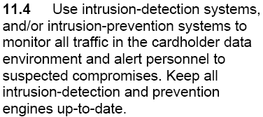
Intrusion Detection System (IDS)
Proving the Internet is evil™
Protecting the network by blacklisting all evil…
IDS/IPS is not all bad:
It is very good for detection anomalies

Slide 35
Using your cell phone in datacenters…
Why?

Slide 36
Interference has happened…
Image taken from www.muscom.nl

Slide 37
Its because of the cameras…

Slide 38
Lets get serious…
</RANT>

Slide 39
Compliance…
Compliance (e.g. PCI compliance) put a business driver into security
If you implement these security measures you will get a discount
Firewalls
IDS
Regular vulnerability scan
Physical security
Expect a business decision

Slide 40
If all you got is a hammer…
Everything looks like a nail…
Consider what you need to secure, before you decide how to…

Slide 41
Do not disengage your brain…

Slide 42
What is the risk?

Slide 43
Questions?
?

Slide 44
Feedback...
Please send/tell me your examples of
non-security through stupidity
Email: fbreedijk@schubergphilis.com
Twitter: @seccubus
Blog: http://cupfighter.net
Project: http://seccubus.com
Company: http://schubergphilis.com

